Slide 1
CHARGE QUBIT Dipole COUPLING

Slide 2
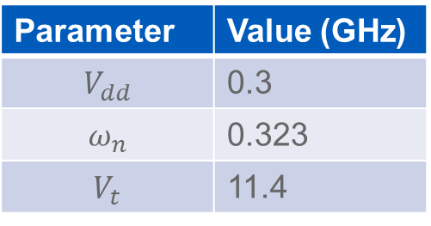
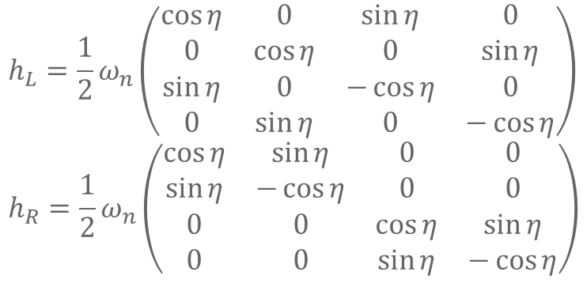

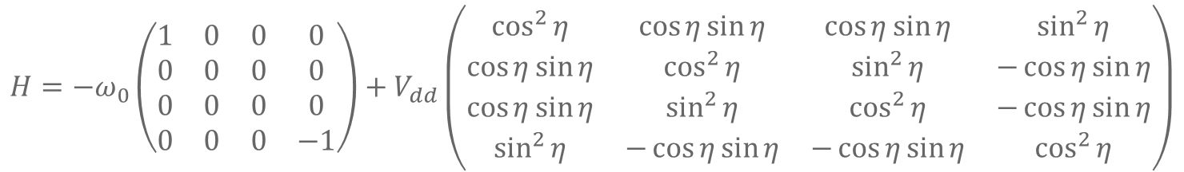





Charge Dipole Coupling
$$H=−ω_{0}\left(\begin{matrix}1 & 0 & 0 & 0 \\ 0 & 0 & 0 & 0 \\ 0 & 0 & 0 & 0 \\ 0 & 0 & 0 & −1\end{matrix}\right)+V_{dd}\left(\begin{matrix}\cos^{2}{η} & \cos{η}\sin{η} & \cos{η}\sin{η} & \sin^{2}{η} \\ \cos{η}\sin{η} & \cos^{2}{η} & \sin^{2}{η} & −\cos{η}\sin{η} \\ \cos{η}\sin{η} & \sin^{2}{η} & \cos^{2}{η} & −\cos{η}\sin{η} \\ \sin^{2}{η} & −\cos{η}\sin{η} & −\cos{η}\sin{η} & \cos^{2}{η}\end{matrix}\right)$$
$$h_{L}=\frac{1}{2}ω_{n}\left(\begin{matrix}\cos{η} & 0 & \sin{η} & 0 \\ 0 & \cos{η} & 0 & \sin{η} \\ \sin{η} & 0 & −\cos{η} & 0 \\ 0 & \sin{η} & 0 & −\cos{η}\end{matrix}\right) \\ h_{R}=\frac{1}{2}ω_{n}\left(\begin{matrix}\cos{η} & \sin{η} & 0 & 0 \\ \sin{η} & −\cos{η} & 0 & 0 \\ 0 & 0 & \cos{η} & \sin{η} \\ 0 & 0 & \sin{η} & −\cos{η}\end{matrix}\right)$$
$$ω_{0}$$
$$V_{t}$$
According to Mathematica, this is exactly solvable. It’s not nice though but we can avoid having to use perturbation theory and instead just do a series expansion as the very last step.
$$η$$
$$ε$$
Parameter | Value (GHz)
$$V_{dd}$$ | 0.3
$$ω_{n}$$ | 0.323
$$V_{t}$$ | 11.4
$$H_{dd}=V_{dd}Z_{1}Z_{2}$$
$$V_{dd}=e^{2}d_{1}d_{2}/16πεr^{3}$$

Slide 3
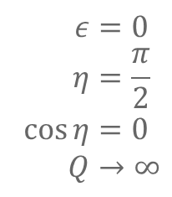

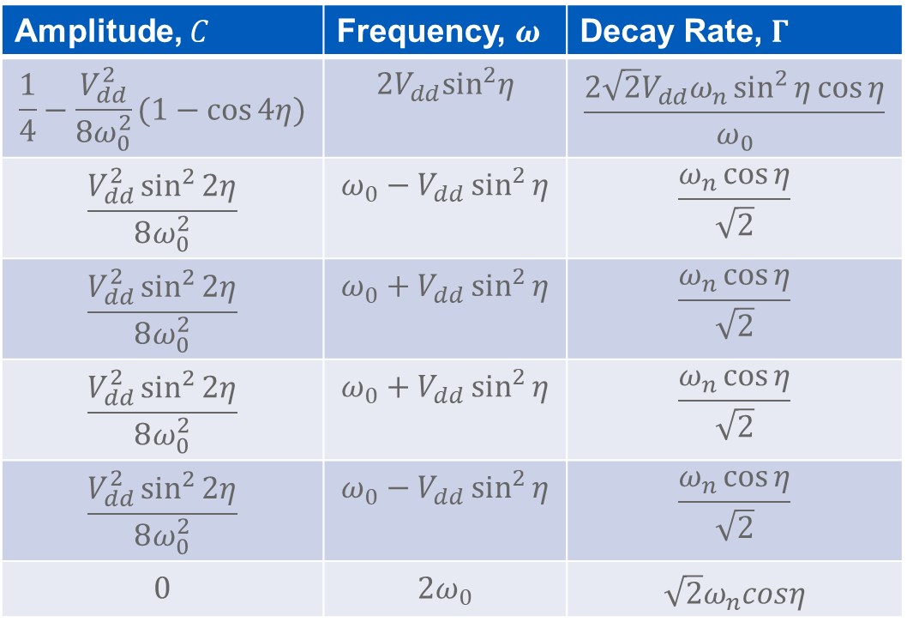
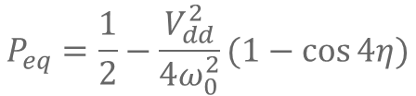
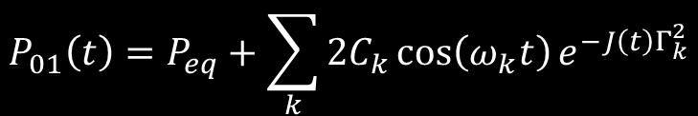
$$V_{dd}≪ω_{0}$$
$$P_{01}\left(t\right)=P_{eq}+\sum_{k}{2C_{k}\cos\left(ω_{k}t\right)e^{−J\left(t\right)Γ_{k}^{2}}}$$
$$P_{eq}=\frac{1}{2}−\frac{V_{dd}^{2}}{4ω_{0}^{2}}(1−\cos{4η})$$
Amplitude, $C$ | Frequency, $ω$ | Decay Rate, $Γ$
$$\frac{1}{4}−\frac{V_{dd}^{2}}{8ω_{0}^{2}}(1−\cos{4η})$$ | $$2V_{dd}\sin^{2}η$$ | $$\frac{2\sqrt{2}V_{dd}ω_{n}\sin^{2}{η}\cos{η}}{ω_{0}}$$
$$\frac{V_{dd}^{2}\sin^{2}{2η}}{8ω_{0}^{2}}$$ | $$ω_{0}−V_{dd}\sin^{2}{η}$$ | $$\frac{ω_{n}\cos{η}}{\sqrt{2}}$$
$$\frac{V_{dd}^{2}\sin^{2}{2η}}{8ω_{0}^{2}}$$ | $$ω_{0}+V_{dd}\sin^{2}{η}$$ | $$\frac{ω_{n}\cos{η}}{\sqrt{2}}$$
$$\frac{V_{dd}^{2}\sin^{2}{2η}}{8ω_{0}^{2}}$$ | $$ω_{0}+V_{dd}\sin^{2}{η}$$ | $$\frac{ω_{n}\cos{η}}{\sqrt{2}}$$
$$\frac{V_{dd}^{2}\sin^{2}{2η}}{8ω_{0}^{2}}$$ | $$ω_{0}−V_{dd}\sin^{2}{η}$$ | $$\frac{ω_{n}\cos{η}}{\sqrt{2}}$$
$$0$$ | $$2ω_{0}$$ | $$\sqrt{2}ω_{n}cosη$$
$$Q=\frac{ω_{0}}{\sqrt{2} ω_{n}\cos{η}}$$
At CQSS
$$ε=0 \\ η=\frac{π}{2} \\ \cos{η}=0 \\ Q→∞$$

Slide 4
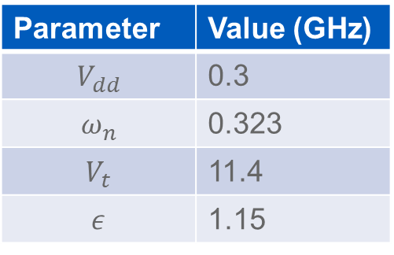
Parameter | Value (GHz)
$$V_{dd}$$ | 0.3
$$ω_{n}$$ | 0.323
$$V_{t}$$ | 11.4
$$ε$$ | 1.15

Slide 5
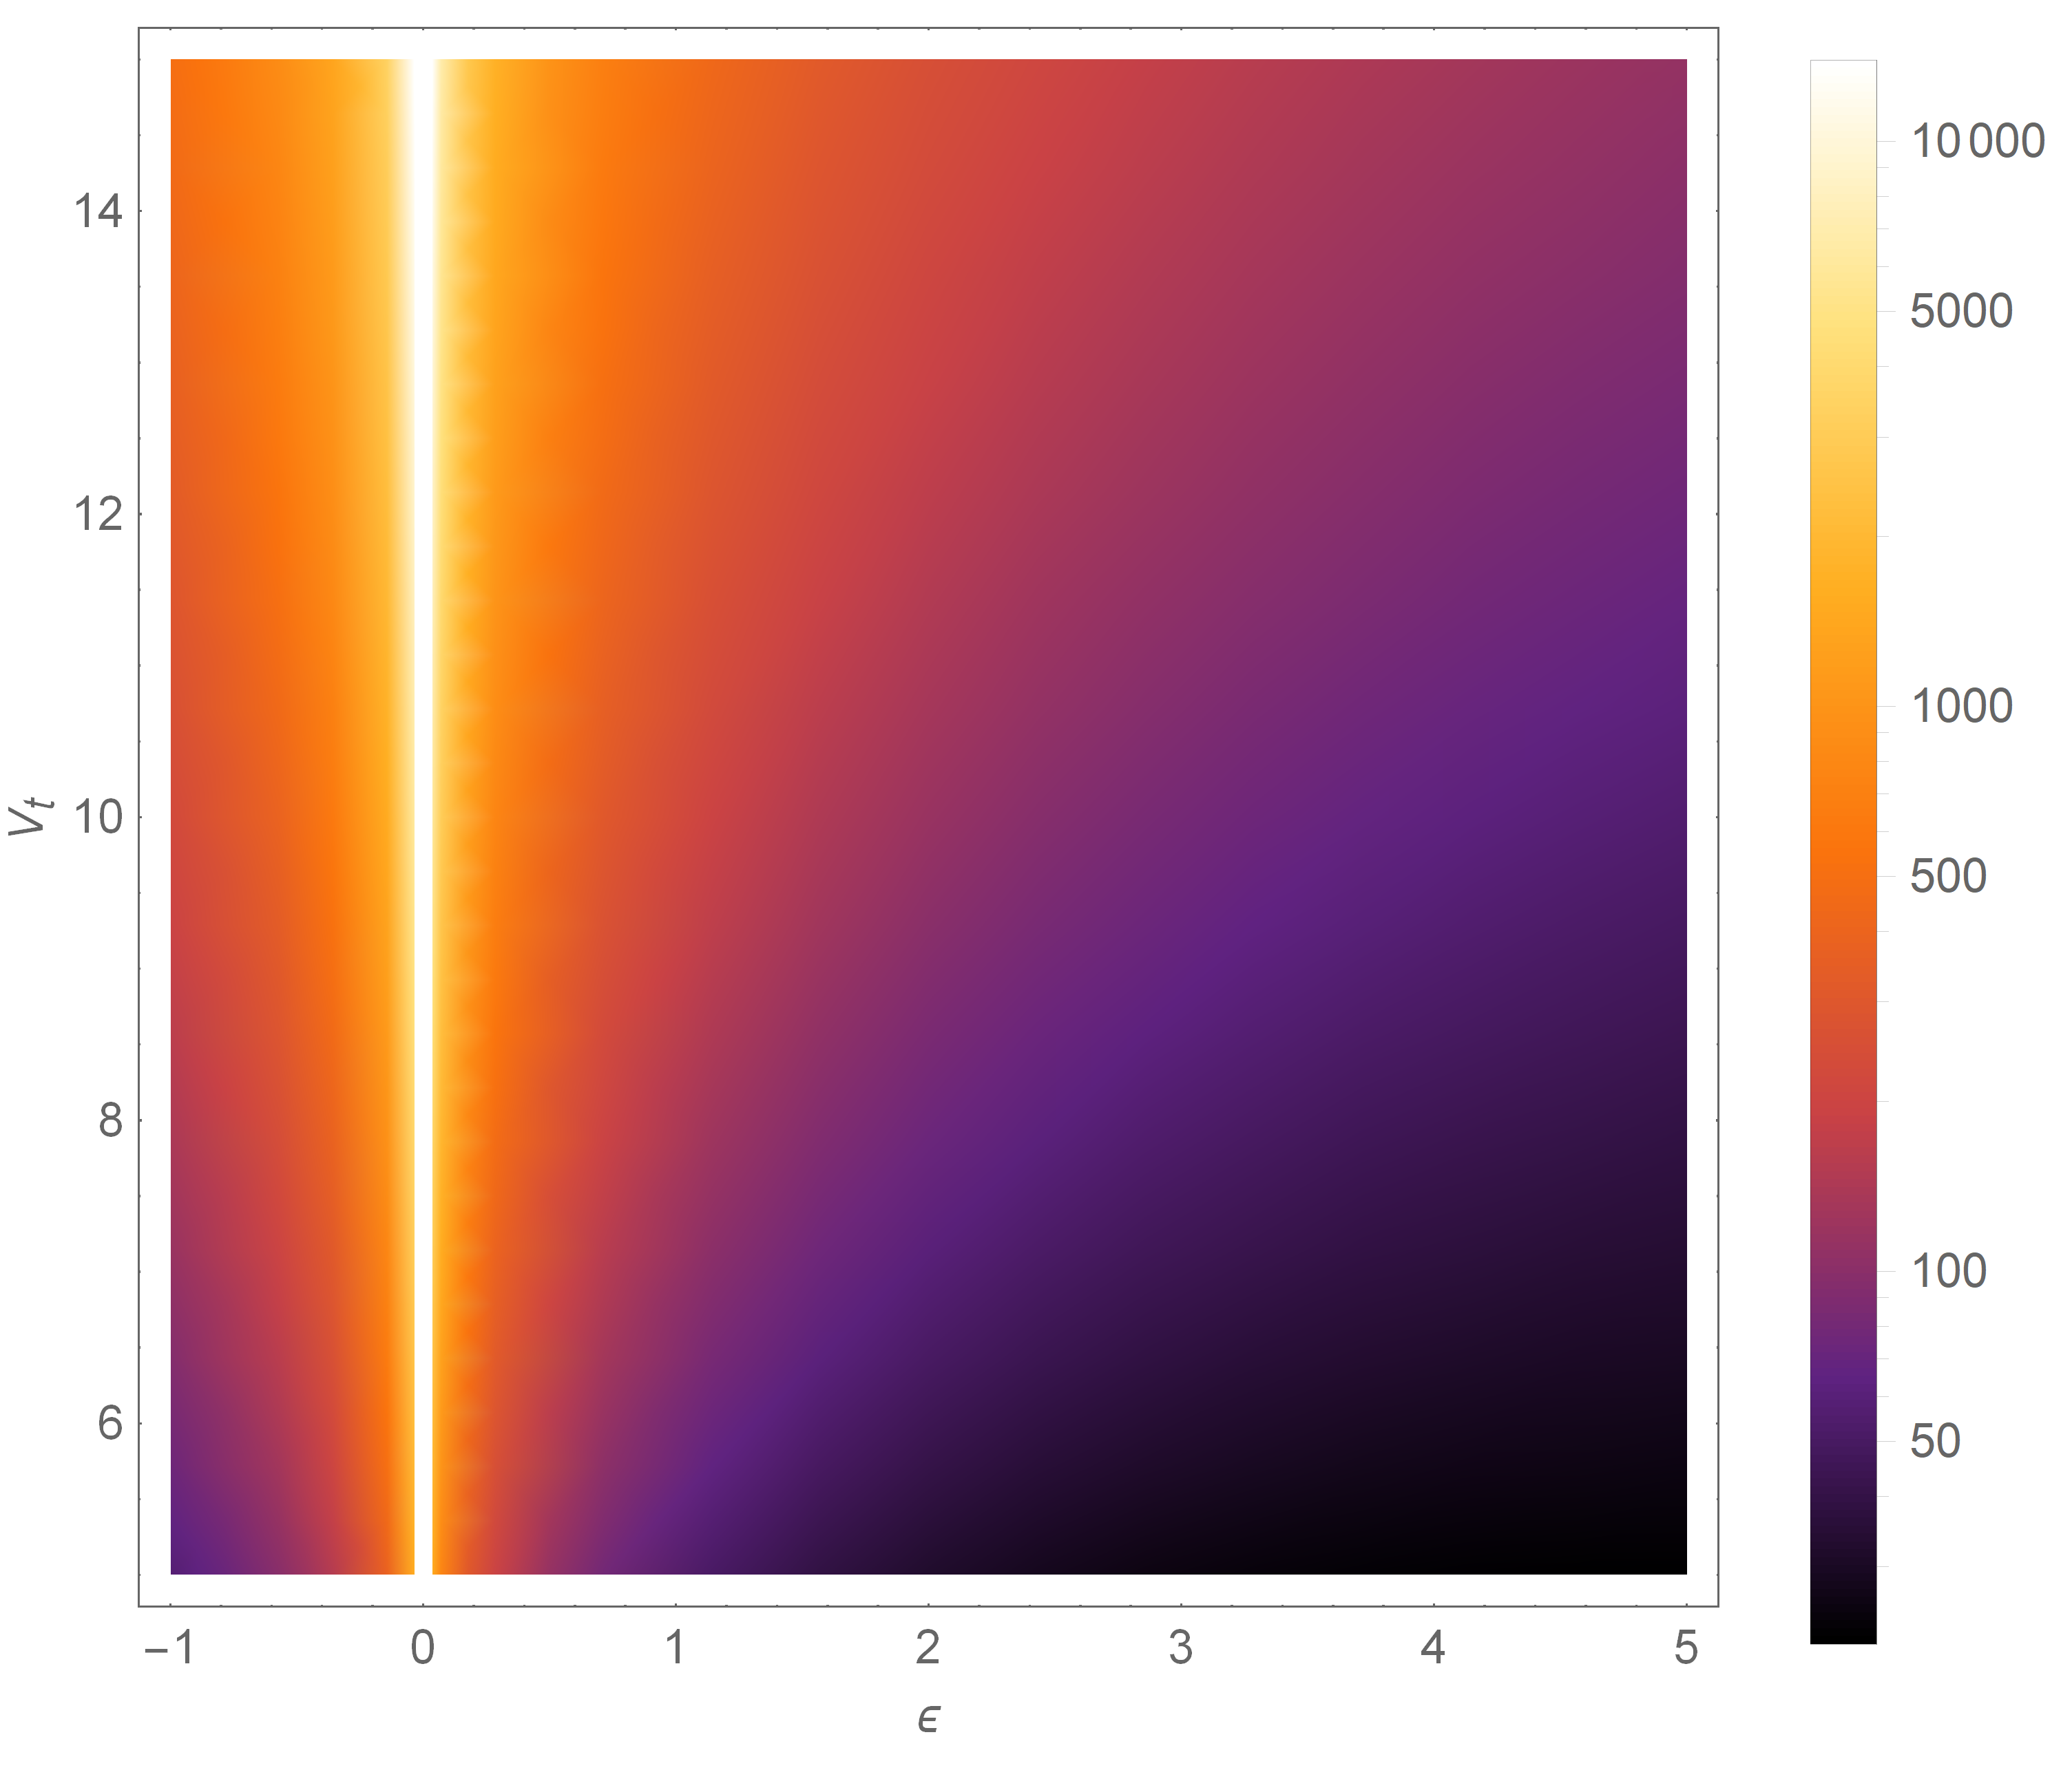
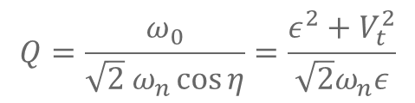
Quality Factor
$$Q=\frac{ω_{0}}{\sqrt{2} ω_{n}\cos{η}}=\frac{ε^{2}+V_{t}^{2}}{\sqrt{2}ω_{n}ε}$$

Slide 6
Extra Figures

